Slide 1
Barriers, Breakthroughs, and Progress in Rare Cancer
September 27, 2023
2:00 pm ET

Slide 2
OUR MISSION
We improve the health and well-being of people with rare diseases by driving advances in care, research, and policy.

Slide 3

Register Here

Slide 4
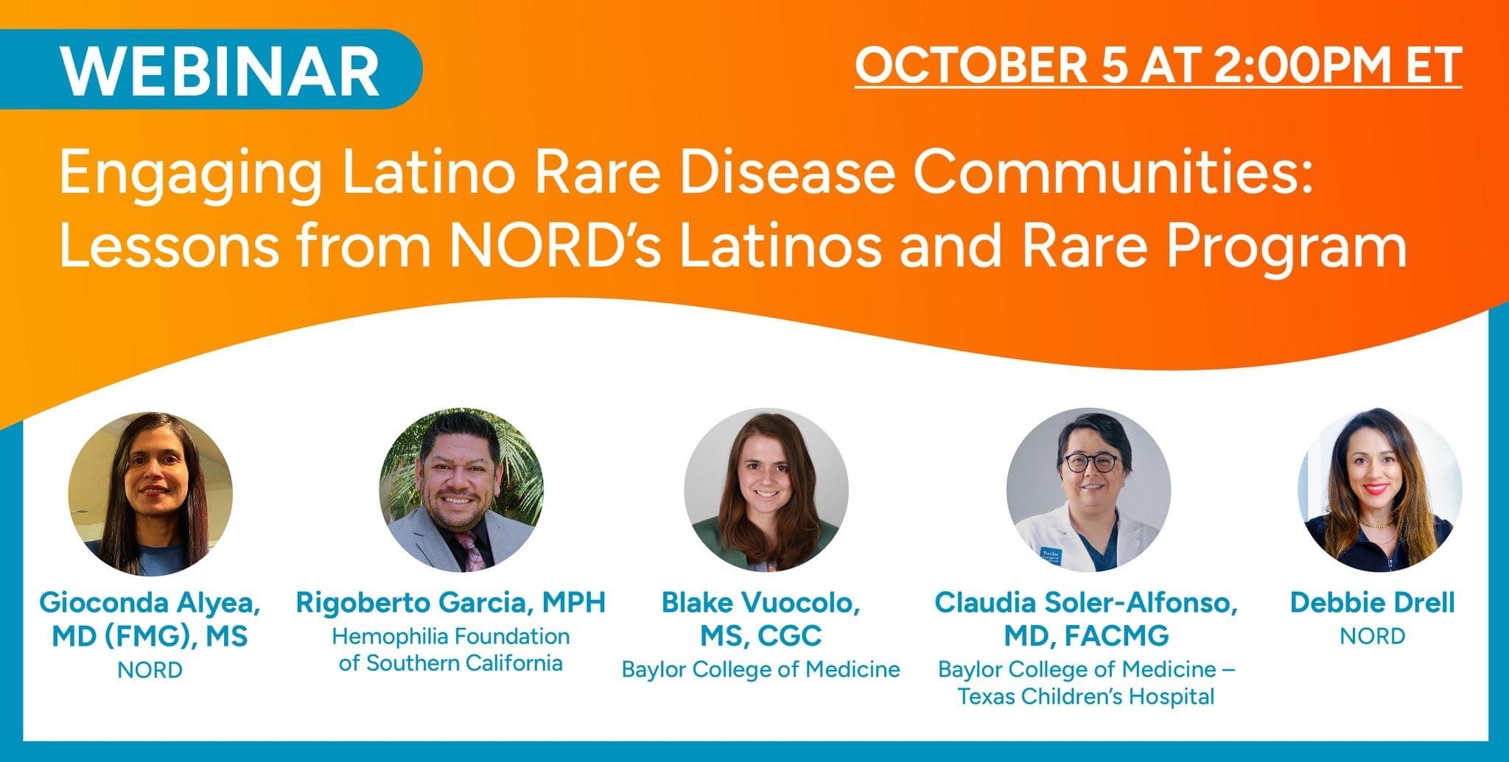
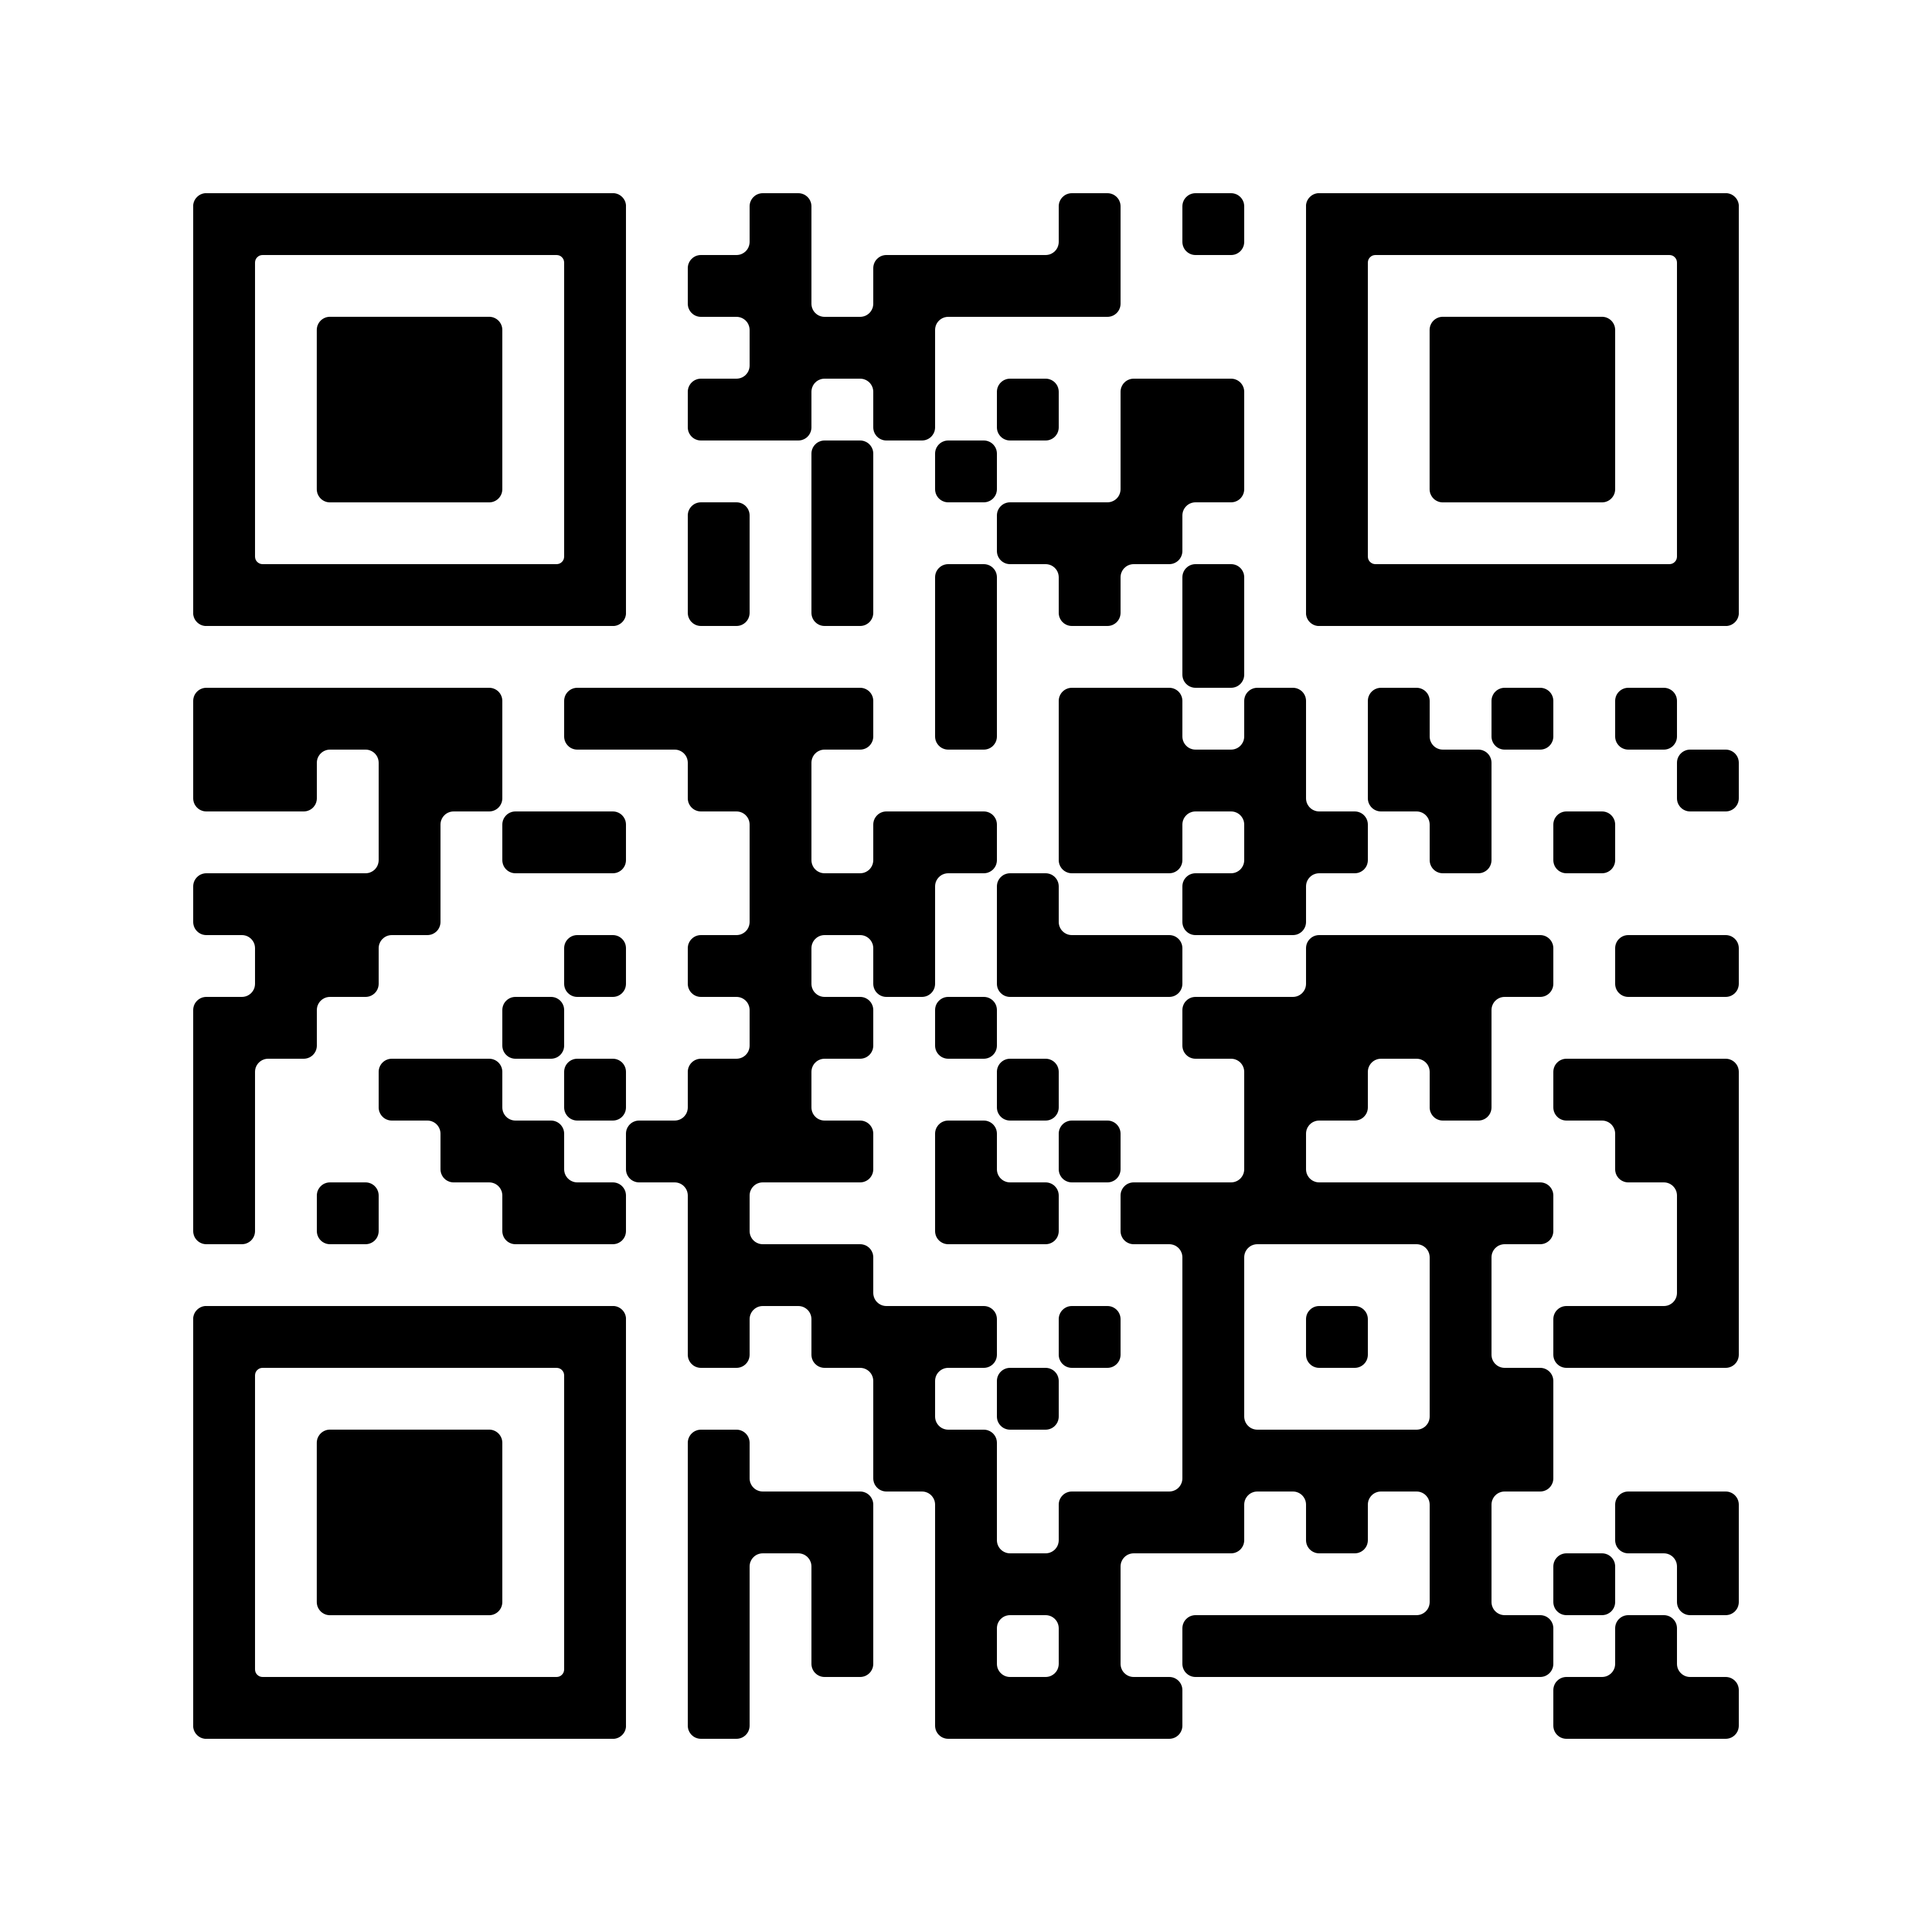
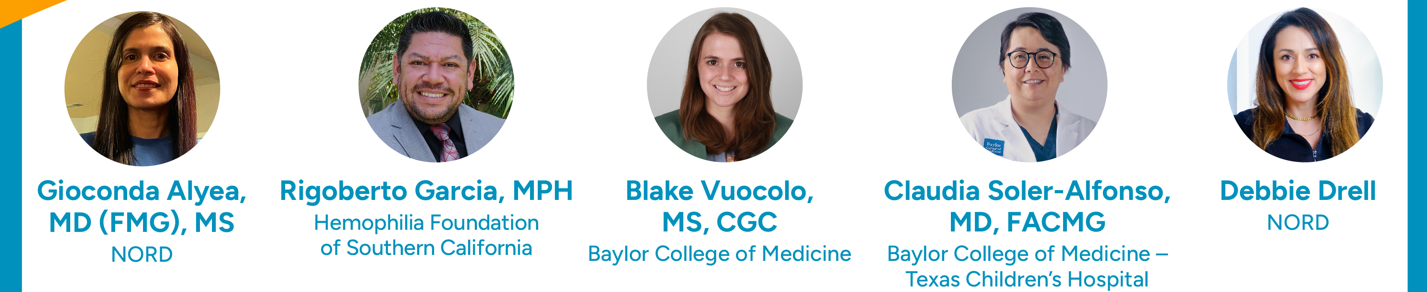
Engaging Latino Rare Disease Communities: Lessons from NORD’s Latinos and Rare Program
Learn how NORD developed its Latinos and Rare Listening Session incl. engagement strategies & best practices.
Identify some of the barriers to care, diagnosis, and treatment that exist in the Hispanic and Latinx community among rare disease patients and families.
Identify new ways for your organization to increase access to programs and resources serving Latino/a/x rare disease community members.
Learn how to learn from and collaborate with medical institutions to engage with patients.
Thursday, October 5th
2:00 – 3:10 pm ET

Slide 5
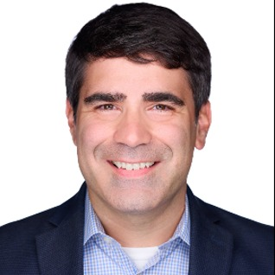
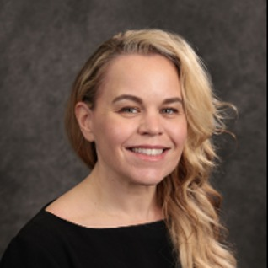
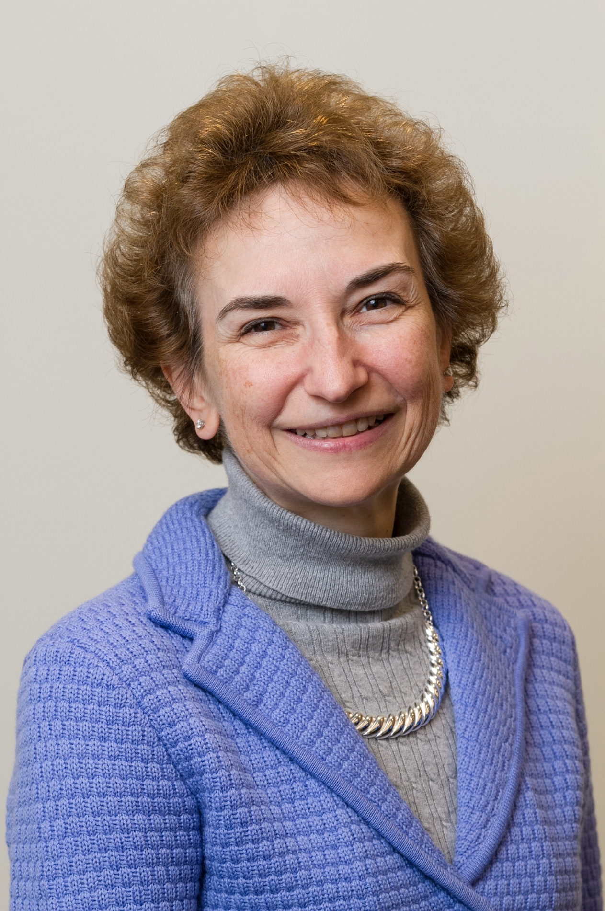
FACILITATOR & PANELISTS
Jim Palma
CEO,
Target Cancer Foundation
Kelly Mercier, PhD
Principal Investigator,
Desmoid Tumor Research Founation
Abby Sandler, PhD
Executive Director,
MyPart, NCI

Slide 6
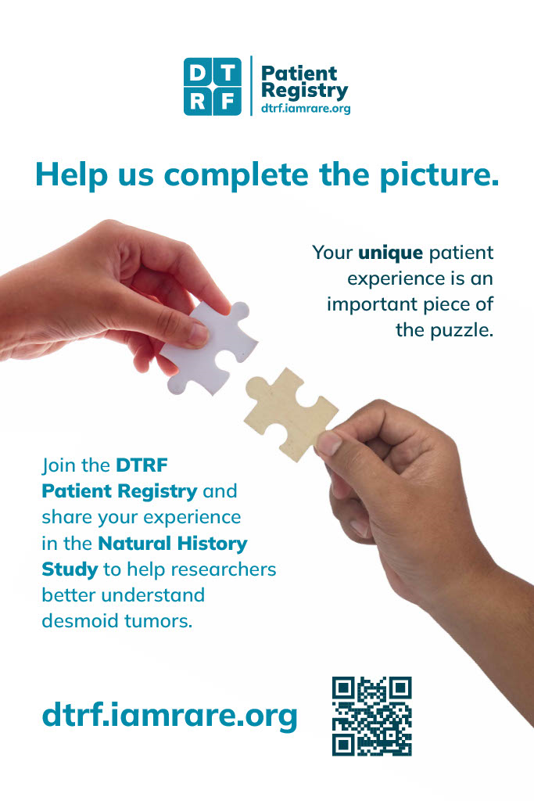
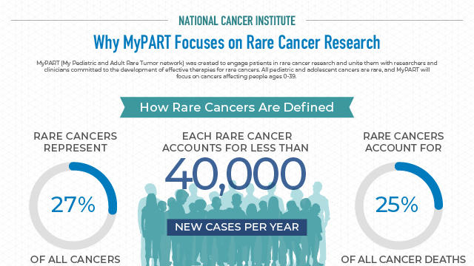
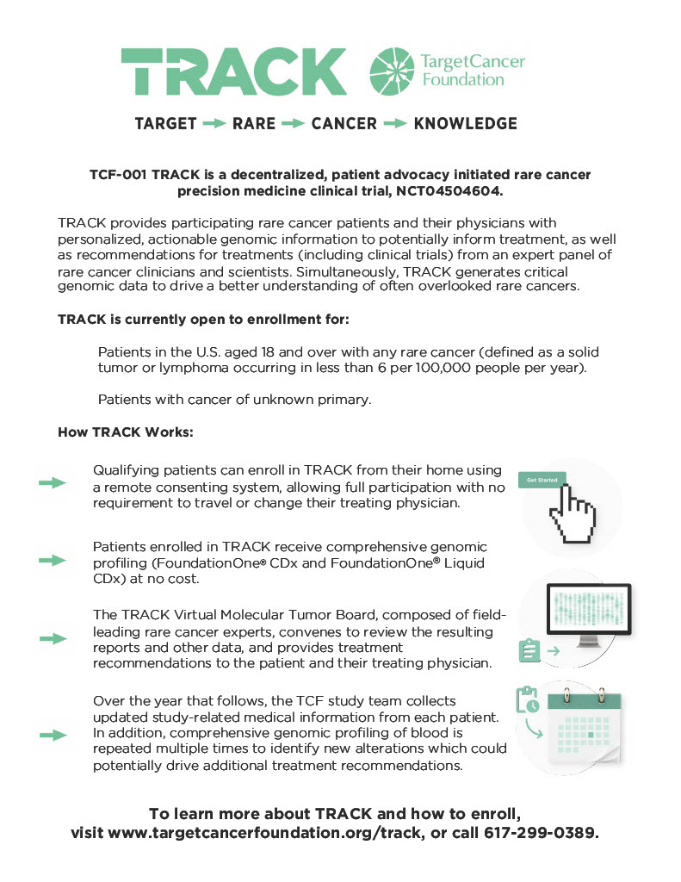
RESOURCES
MyPART website

Slide 7





ALONE WE ARE RARE. TOGETHER WE ARE STRONG®.
FOR MORE INFORMATION ABOUT NORD, VISIT: rarediseases.org or call 203.744.0100
Donations to NORD for these and other programs may be made by
contacting orphan@rarediseases.org.
©2023 NORD. All rights reserved. NORD®, its icon, tagline are registered trademarks of The National Organization for Rare Disorders.

